Slide 1
FOLFOXIRI Plus Bevacizumab (BEV) Versus
FOLFIRI Plus BEV as First-Line Treatment of mCRC: Updated Survival Results
of the Phase III TRIBE Trial by the GONO Group
Abstract 657
Cremolini C, Loupakis F, Masi G, Zagonel V, Bergamo F,
Salvatore L, Cortesi E, Tomasello G, Ronzoni M, Pinta F, Zaniboni A, Tonini G, Buonadonna A, Amoroso D, Sonaglio C, De Stefano A,
Boni C, Allegrini G, Boni L, Falcone A

Slide 2

TRIBE Study Desgin
FOLFIRI + BEV
(up to 12 cycles)
5FU/LV + BEV
PD
508 patients with mCRC
First line
Unresectable
Stratified by
Center
PS 0/1-2
Adjuvant chemo
R
FOLFOXIRI + BEV
(up to 12 cycles)
5FU/LV + BEV
Primary endpoint: Progression-free survival (PFS)
Participating centers: 34 Italian oncology units
First patient in: July 2008
Last patient in: May 2011
5FU/LV, fluorouracil/leucovorin; PD, progressive disease
Cremolini C, et al. J Clin Oncol. 2015;33(suppl 3): Abstract 657.

Slide 3
Background
Phase III TRIBE trial met its primary endpoint PFS. FOLFOXIRI plus bev, as compared to FOLFIRI plus bev
Improved Progression Free Survival (HR: 0.75, P = .003)
Increased the RECIST Response Rate (65% vs 53%, P = .006)
Increased the incidence of specific G3/4 adverse events (diarrhea, mucositis, neuropathy, neutropenia), but not of febrile neutropenia, serious adverse events and treatment-related deaths
At the preliminary OS analysis (56% of death events), prolonged Overall Survival with a trend toward significance (HR: 0.79, P = .054) becoming significant at the adjusted analysis (HR: 0.72, P = .010)
Loupakis F, et al. N Engl J Med. 2014;371(17):1609-1618
Cremolini C, et al. J Clin Oncol. 2015;33(suppl 3): Abstract 657.

Slide 4
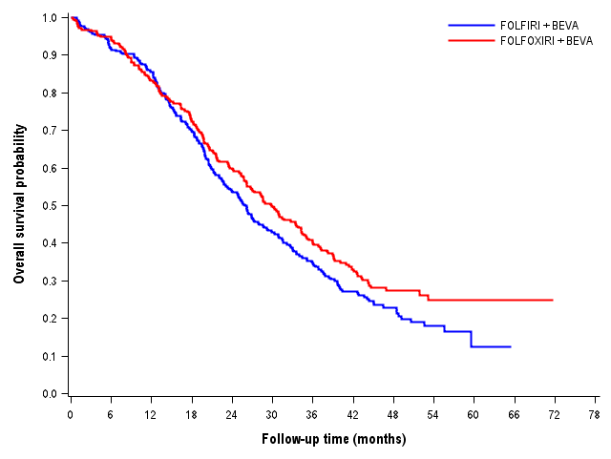
Updated Overall Survival (OS) Results
Median follow up: 48.1 months
(74% of death events)
FOLFIRI + BEV: N = 256 / Died = 200
FOLFOXIRI + BEV: N = 252 / Died = 174
FOLFIRI + BEV, median OS : 25.8 months
FOLFOXIRI + BEV, median OS : 29.8 months
HR: 0.80 [0.65-0.98]
P = .030
5 years-OS rate
24.9% vs 12.4%
Cremolini C, et al. J Clin Oncol. 2015;33(suppl 3): Abstract 657.

Slide 5
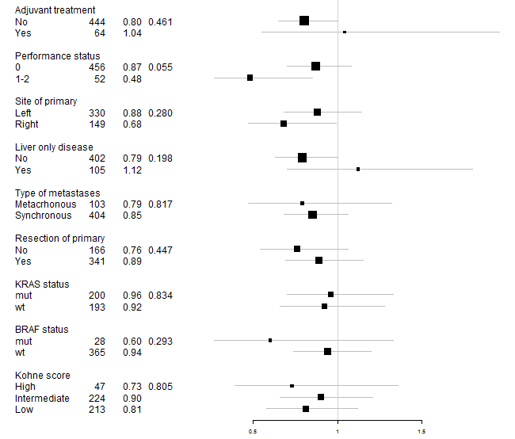
Subgroup Analyses: OS
Factor N HR
P for interaction
0.5
1.0
1.5
FOLFOXIRI Plus BEV Better
FOLFIRI Plus BEV Better
Cremolini C, et al. J Clin Oncol. 2015;33(suppl 3): Abstract 657.

Slide 6
Second-Line Treatments
 | FOLFIRI + BEV Arm A | FOLFOXIRI + BEV Arm B
Potential candidates to second line | 88.7% (227/256) | 86.9% (219/252)
Any second-line therapy | 79.3% (180/227) | 80.4% (176/219)
Second-line agents | N = 180 | N = 176
Fluoropyrimidine, % | 93% | 81%
Oxaliplatin, % | 63% | 26%
Irinotecan, % | 32% | 63%
Bevacizumab, % | 31% | 32%
Anti-EGFR mAB, % | 15% | 29%
Third-line anti-EGFR mAB, %
 | 21% | 13%
Cremolini C, et al. J Clin Oncol. 2015;33(suppl 3): Abstract 657.

Slide 7
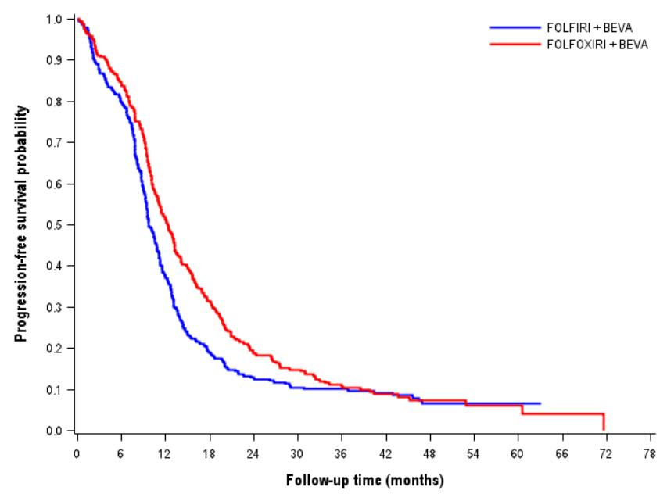
Updated PFS Results
Median follow up: 48.1 months
(74% of death events)
FOLFIRI + BEV: N = 256 / Progressed = 236
FOLFOXIRI + BEV: N = 252 / Progressed = 232
FOLFIRI + BEV, median PFS : 9.7 months
FOLFOXIRI + BEV, median PFS : 12.3 months
HR: 0.77 [0.65-0.93]
P = .006
Cremolini C, et al. J Clin Oncol. 2015;33(suppl 3): Abstract 657.

Slide 8
Conclusions
Updated results of the TRIBE study demonstrate that first-line induction FOLFOXIRI plus BEV as compared to FOLFIRI plus BEV significantly improves OS of molecularly unselected mCRC patients (median OS 29.8 vs 25.8 months, HR: 0.80, P = .030)
The advantage in survival increases over time with an estimated 5-year OS rate of 24.9% vs 12.5%
The significant effect on PFS is confirmed (HR: 0.77, P = .006) with a median PFS of 12.3 vs 9.7 months
Based on these results FOLFOXIRI plus BEV represents a new valuable option for the upfront treatment of unresectable mCRC patients.
Cremolini C, et al. J Clin Oncol. 2015;33(suppl 3): Abstract 657.

